Slide 1
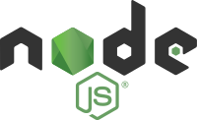
Introduction to Node JS

Slide 2
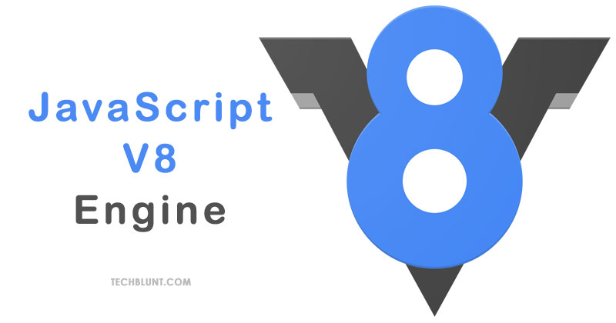
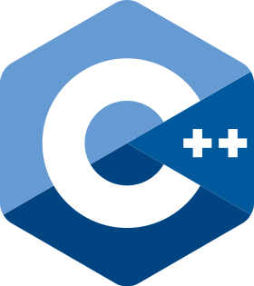
Introduction
We can create front end and backend applications using Javascript.
Node js is a Javascript runtime build on chrome v8 Javascript engine using C++.
Node js is Javascript running on the server.
Node js is not a programming language or software development framework.

Slide 3
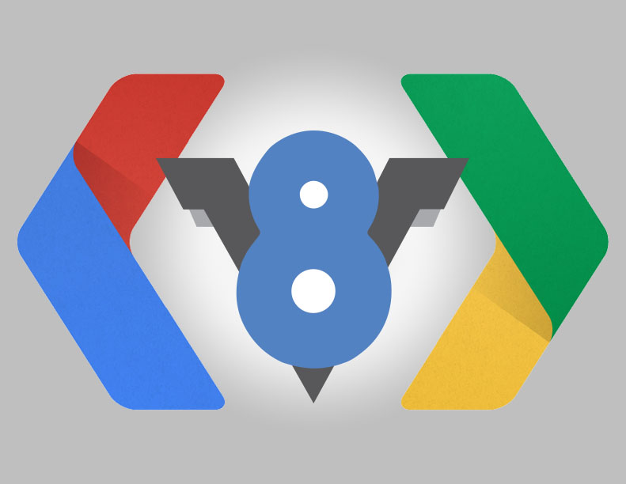

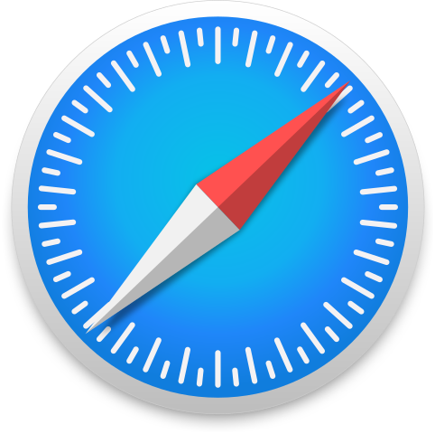
History of Node Js
Google V8 Engine
In 1995 Netscape Written a Program Enterprise Server allow developer to run Javascript on server (But its not Popular).
2009 and idea from Ryan Dahl (Google Engine).
He took V8 Engine and embedded with C++ Program and called it Node.exe (Later named as Node Js)
Mozilla MonkeySpider
Safari Nitro

Slide 4
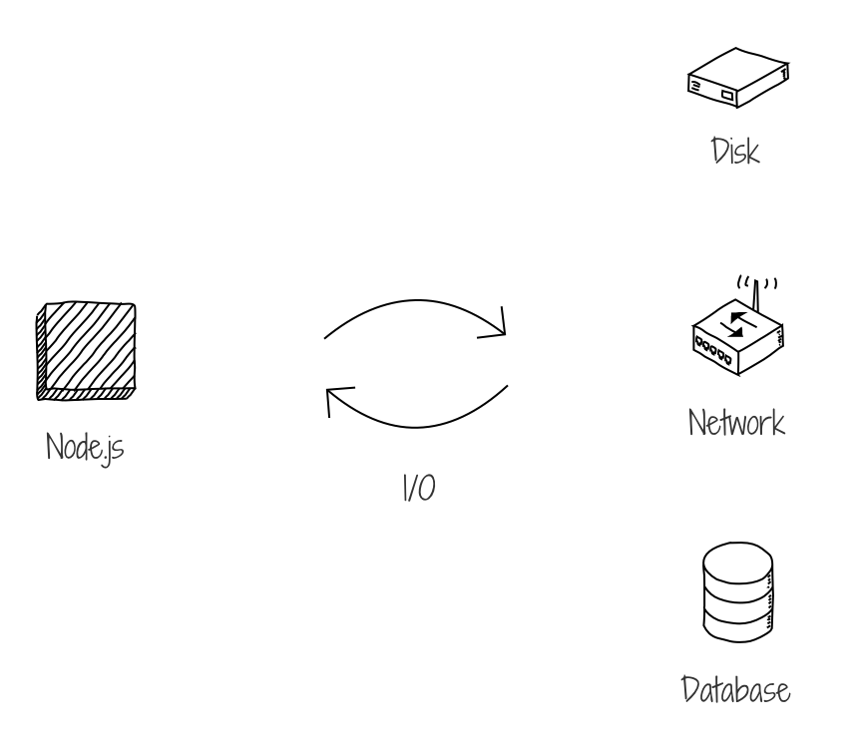
When to use Node JS?
I/O Bound
Data Streaming Applications (Netflix, Facebook etc.)
Real time chat Applications (WhatsApp etc.)

Slide 5
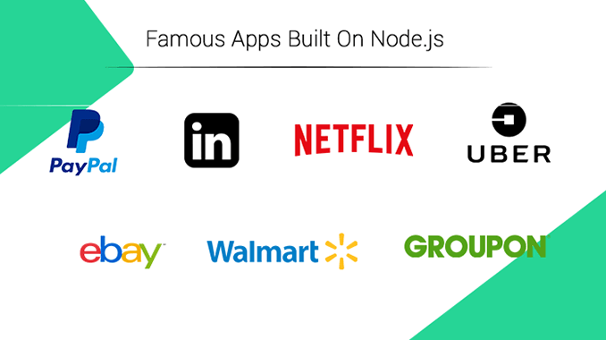
Famous Application Built on Node JS

